Slide 2
Vision of St. Catherine-St. Lucy School
To be a symbol of peace, excellence, and love in our community.
St. Catherine - St. Lucy School Root Beliefs
We believe we are all children of God.
We believe there is more to learning than just books.
We believe education is a civil right.
We believe students are active participants in their learning process.
We believe in educating the whole student in a balanced program - physically, spiritually, socially, and academically.
We believe people can grow and change.

Slide 3
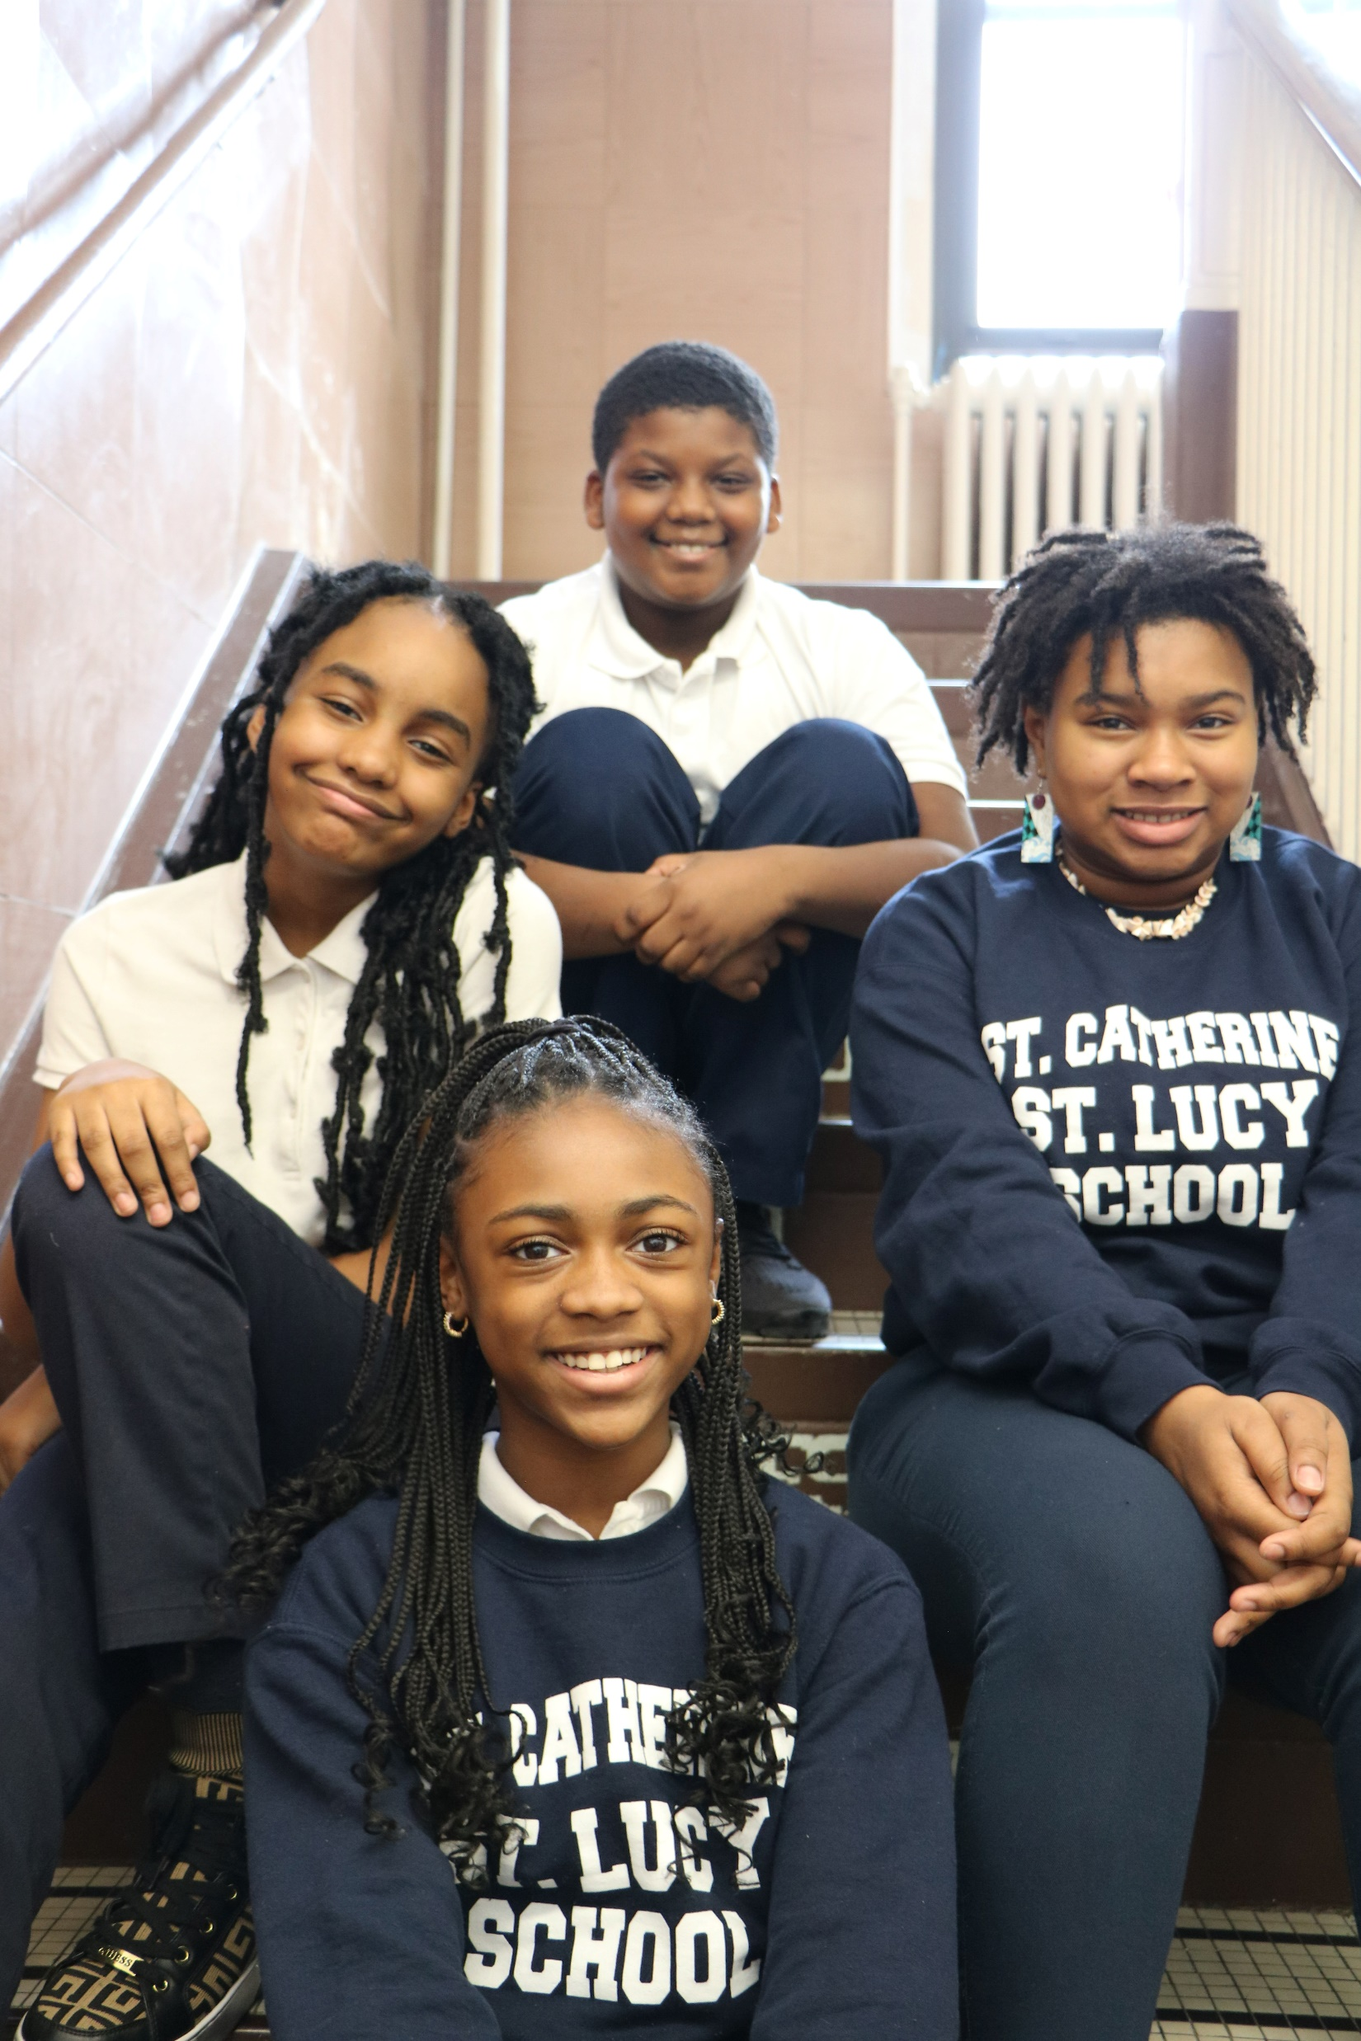
Scholarships & Support
Scholarship Opportunities
Big Shoulders Fund
Tax Credit Scholarship
Driscoll Scholarship und
Horizons For Youth Scholarship
Community Resource Board Fund
Where there is a will, there is a way!
We believe if you want to send your child to SCSL School, we will find a way to make that happen!
We accept Illinois Action for Children and have access to scholarship and support funds.

Slide 4
SCSL is a Personalized Learning School
St. Catherine - St. Lucy was one of three schools in the Archdiocese of Chicago to lead the way in piloting a cutting edge "blended learning" program offered through Leap Innovations (Chicago) and a $1 million grant from the Chicago Mercantile Exchange. This modern method of personalizing the learning environment is a real game changer for our students!
What is
Personalized Learning?
It is the meaningful design of blended instruction to combine face-to-face teaching, technology-assisted instruction and student-to-student collaboration to leverage each student’s interests for deeper learning.
An example of
Personalized Learning:
While reading a short story, students can choose between just reading or reading along as they listen to a story. They can also decide whether to annotate online or on a printed copy. They can take notes on paper or record their thoughts verbally as they analyze the story
Focusing on student interests and areas of academic strength or weakness, Personalized Learning helps increase student learning and engagement. Students face zero pressure to try and keep pace with peers. In a personalized learning environment, students often learn faster and learn better than they would in a traditional classroom.
Benefits:

Slide 5
Preschool A full day program welcoming our earliest learners and building the foundation for a lifetime love of learning!
Correctly name familiar colors
Understand the idea of same and different, start comparing sizes
Pretend play & creativity encouraged
Follow three-part commands
Preschool 3
Special Weekly Classes
Yoga
Computers
Gym
Music
Peacemakers
Preschool 4
Emphasis on Social Emotional Learning
Physical Development
Cognitive Development
Language Development

Slide 6
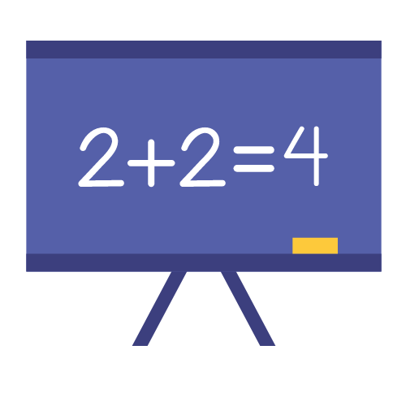
Kindergarten
Teacher
Mrs. Gina Lenigan, 5 years at SCSL School
Mrs. House, aid
Overview
Warm, fun, and challenging! Our students progress through learning centers and work within small groups or receive one-on-one instruction.
Language Arts
Focus on:
Capitalization, punctuation, and spelling when writing
Recognize and name end punctuation
Write a letter or letters for most consonant and short-vowel sounds
Spell simple words phonetically
Math
Focus on:
Numbers & Counting
Sorting & Classifying
Shapes & graphs
Adding & Subtracting
Science / Social Sciences
Focus on:
Basics of physical science and earth science
Learn scientific skills such as observing & how to communicate effectively
Specials: yoga, computer, music, gym, library, Peacemakers

Slide 7
1st Grade Kindness, Community, Respect “Big Kids” setting the example
Teacher
Mr. Mike Riemma, 7 years at SCSL School
There’s much to learn in 1st grade! Why not make it fun? Mr. Riemma is a believer in the power music and sets many of his lessons to a tune. Embracing the belief of educating the whole child, Mr. Riemma builds a beautiful community of learners who share kindness and respect. And… Read! Read! Read!
Readers Are Leaders!
Phonics / Language Arts
Using the Sadlier series, the focus is on:
Teach clusters of skills in a preset sequence—first in isolation, then in context of words, decodable and connected text, and student writing.
Math
Focus is on:
Numbers & Counting
Classifying & Estimating
Shapes, graphs, data analysis
Adding & Subtracting
Science
Focus is on:
Life science (plants, animals, habitats)
Earth and space science (solar system and beyond)
Water cycle and weather
Social Studies
Focus is on:
Maps
Community
Responsible citizenship
Specials:
yoga, computer, music, gym, library, Peacemakers

Slide 8
2nd Grade
INDEPENDENCE
Develop the ability to
work well on your own
RESPONSIBILITY
Taking ownership for self and caring for others
LEADERSHIP
Working to build leaders in 2nd grade
+
=
Teacher
Mrs. Okoeguale, 28 years at SCSL School
Language Arts
Building fluency and accuracy
Reading for comprehension
Basic mechanics of parts of speech
Improving vocabulary and spelling
Mechanics of reading and storytelling through silent individual and shared group reading
Math
Adding and subtracting 2-didgit numbers
Basic problem solving - one to two steps
Intro to basic geometry and basic measurement
Telling time
Science
Ecosystems
Food chains
Space and Matter
Social Studies
African American History
Community and neighborhood
Religion
Learn 36 scriptures from the bible – one per week for 36 weeks
Weekly assessments
Specials
Yoga, computer, gym 2x week, music, library and Peacemakers.

Slide 9
3rd Grade
Discipline, Accountability, Responsibility, Time Management
Mrs. Sharon Bryant, 30 years at SCSL School
English / Language Arts
*transition from learning to read to reading to learn
*analyze literature through story elements
*analyze informational text using text features
*demonstrate comprehension by using text evidence
* basic understanding of nouns, verbs, adjectives, adverbs, and pronouns
*paragraph writing
*informational and research writing
Math
*writing 4 digit numbers in various forms
*rounding to nearest 10 or 100
*multi-digit addition/subtraction w/regrouping
*multiplication/division fact fluency
*basic understanding of fractions and geometry
Science
*animal Classification
*habitats
*animal adaptations
*inherited traits
*fossils
Social Studies
*ommunities
*Native Americans
*Colonial America
*Early American History
*map skills

Slide 10
4th Grade
Students transition from Learning to Read to Reading to Learn
Teacher:
Mrs. Tara Patterson, 13 years at SCSL School
Reading / Spelling / Phonics: Parts of speech, sentence structure, building vocabulary, editing, different types of writing
Math: Place value, multiplication, long division, fractions and decimals
Science: Interdisciplinary project-based approach to STEM learning partnering with SparkShop.
Religion: Old Testament and New Testament and learning about our place in God’s world.
Every Friday, students have the opportunity to “catch up” on any missed work and “pick” something fun to do if they’ve completed all their work.
Specials
Yoga, computer, gym 2x week, music, library and Peacemakers.

Slide 11
5th Grade
RESPECTFUL
Respect yourself. Respect others. Respect will come to you.
Teacher: Ms. Vanessa Underwood, 3 years at SCSL School and SCSL Class of 1999 graduate
Math
Multiply and divide fractions
Explain numerical expressions
Deepen understanding of geometric principles
Develop strategies for problem solving.
Science
Food chain
Ecosystems
creating protypes
partnership with SparkShop with focus on STEM.
Social Studies
History of the United States with a focus on the State of Illinois.
Language Arts / Reading
Writing & Reading workshops
Building fluency
Increasing vocabulary words / spelling
Specials:
Yoga, computer, music, gym 2x/week, library, Peacemakers

Slide 12
Junior High 6, 7, 8 Grade
What Makes SCSL School Junior High So Special?
Teachers:
Mr. Fred Rogers, 6th grade
Mr. Mike Kennedy, 7th grade
Ms. Arnette Young, 8th grade
Social Studies
Mr. Kennedy teaches social studies to 6th, 7th, 8th
Math
Ms. Young teaches math to 6th, 7th, 8th
Science
Mr. Rogers teaches science to 6th, 7th, 8th
Homeroom teachers instruct their students in Language Arts, Reading, and Religion
Character and Moral Development
Through Christian, faith-based education, we provide our students with a safe place to succeed and a place to learn from their mistakes.
High School Bridge Program
We guide 7th and 8th grade students and families as they:
Research and identify best-fit high schools based on selectivity, affordability, location and support services offered
Prepare and sit for entrance exams
Complete enrollment and scholarship applications
Evaluate financial aid packages
Select a best-fit high school

Slide 13
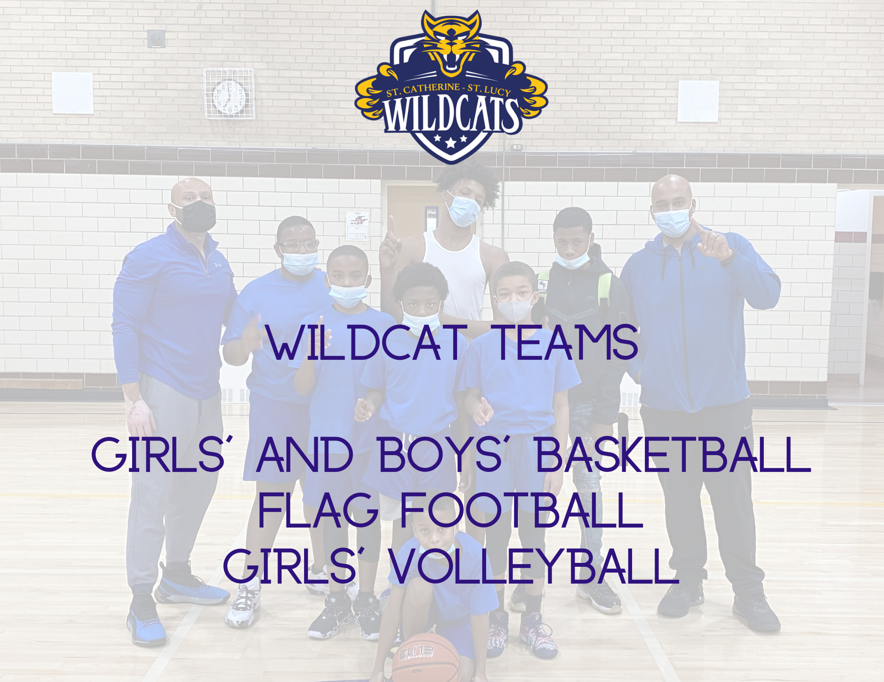

Slide 14
Great Things Are Happening!
Increase in Enrollment
Brand New Gym
New Tutoring Center
Scholarship partner with Fenwick High School

